Slide 1
Introduction to Web Development and Angular 2
Pradeep Maharana
Shreyas Mulay
R V Veeresh Kumar

Slide 2
Course Objectives
- HTML
- JavaScript
- Angular 2
Fundamentals of Angular 2 (MVC, SPA)
Server Side Scripting (Node JS)
Angular CLI Setup
Application Structure
Basic Application
How to Debug
Unit Testing (Karma)
E2E Testing (Protractor)

Slide 3
Html
Telling the browser what to do, and what properties to use.
A series of tags that are integrated into a text document.
Tags are ;
surrounded with angle brackets like this
<B> or <I>.
Most tags come in pairs
exceptions: <P>, <br>, <li> tags …
The first tag turns the action on, and the second turns it off.

Slide 4
Html (cont.)
The second tag(off switch) starts with a forward slash.
For example ,<B> text </B>
can embedded, for instance, to do this:
<HEAD><TITLE> Your text </HEAD></TITLE> it won't work.
The correct order is <HEAD><TITLE> Your text </TITLE></HEAD>
not case sensitivity.
Many tags have attributes.
For example, <P ALIGN=CENTER> centers the paragraph following it.
Some browsers don't support some tags and some attributes.

Slide 5
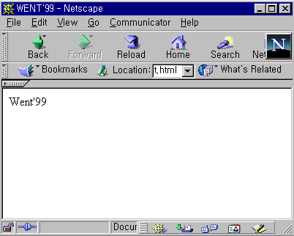
Html (cont.)
<HTML>
<HEAD>
<TITLE>WENT'99</TITLE>
</HEAD>
<BODY>
Went'99
</BODY>
</HTML>
See what it
looks like:

Slide 6
Html (cont.)
How to Create and View an HTML document?
1. Use an text editor such as Notepad to write the document.
2. Save the file as filename.html on a PC. This is called the Document Source.
3. Open Google Chrome (or any browser)
4. Switch to file explorer.
5. Select the filename.html document that you just created.
6. Your HTML page should now appear just like any other Web page in Google Chrome.
*HTML 5 is the latest version available now contains advanced concepts like web worker, canvas, local/session storage etc.

Slide 7
javascript
Why Study JavaScript?
JavaScript is one of the 3 languages all web developers must learn:
1. HTML to define the content of web pages
2. CSS to specify the layout of web pages (presentation)
3. JavaScript to program the behavior of web pages
Advantages of JavaScript:
Less server interaction − You can validate user input before sending the page off to the server. This saves server traffic, which means less load on your server.
Immediate feedback to the visitors − They don't have to wait for a page reload to see if they have forgotten to enter something.
Increased interactivity − You can create interfaces that react when the user hovers over them with a mouse or activates them via the keyboard.
Richer interfaces − You can use JavaScript to include such items as drag-and-drop components and sliders to give a Rich Interface to your site visitors.

Slide 8
Javascript- (cont.)
DataTypes: JavaScript variables can hold many data types: numbers, strings, objects and more
var length = 16; // Number var lastName = "Johnson"; // String var x = {firstName:"John", lastName:"Doe"}; // Object
Variables :- JavaScript variables are containers for storing data values. In this example, x, y, and z, are variables:
var x = 5; var y = 6; var z = x + y;
Functions : - A JavaScript function is a block of code designed to perform a particular task. A JavaScript function is executed when "something" invokes it (calls it).
function myFunction(p1, p2) { return p1 * p2; // The function returns the product of p1 and p2 }

Slide 9
Javascript- (cont.)
JSON Objects: JSON is a format for storing and transporting data. JSON is often used when data is sent from a server to a web page.
What is JSON?
JSON stands for JavaScript Object Notation
JSON is lightweight data interchange format
JSON is language independent *
JSON is "self-describing" and easy to understand
* The JSON syntax is derived from JavaScript object notation syntax, but the JSON format is text only. Code for reading and generating JSON data can be written in any programming language.
This JSON syntax defines an employees object: an array of 3 employee records (objects):
{ "employees":[ { "firstName":"John", "lastName":"Doe“ }, { "firstName":"Anna", "lastName":"Smith“ }, { "firstName":"Peter", "lastName":"Jones“ } ] }

Slide 10
Javascript- (cont.)
JavaScript Arrays :
JavaScript arrays are used to store multiple values in a single variable.
var cars = ["Saab", "Volvo", "BMW"];
Accessing the array:
You refer to an array element by referring to the index number. This statement accesses the value of the first element in cars:
var name = cars[0];
This statement modifies the first element in cars:
cars[0] = "Opel";
*Array and JSON works together to achieve data storage functionality in Angular 2.

Slide 11
Javascript- (cont.)
Callback function:
A callback function is a function that is passed to another function (let’s call this other function “otherFunction”) as a parameter, and the callback function is called or executed inside the otherFunction (after performing some action/operation).
Example:
function onComplete(result) { // callback function
console.log('Result: '+ result);
}
function processUserInput(a, b, callback) {
var sum = a + b ;
callback(sum);
}
processUserInput(10, 20, onComplete);

Slide 12
Angular 2 - One framework. Mobile & desktop.
DEVELOP ACROSS ALL PLATFORMS
SPEED & PERFORMANCE
INCREDIBLE TOOLING
LOVED BY MILLIONS

Slide 13
Angular 2 - One framework. Mobile & desktop.
- Angular is a framework for building client applications in HTML and either JavaScript or a language like TypeScript that compiles to JavaScript.
- The framework consists of several libraries, some of them core and some optional.
- You write Angular applications by composing HTML templates with Angularized markup, writing component classes to manage those templates, adding application logic in services, and boxing components and services in modules.
- Then you launch the app by bootstrapping the root module. Angular takes over, presenting your application content in a browser and responding to user interactions according to the instructions you've provided.
- Of course, there is more to it than this. You'll learn the details in the pages that follow. For now, focus on the big picture.

Slide 14
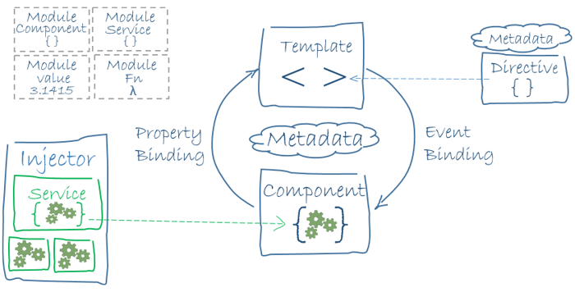
Angular 2 - One framework. Mobile & desktop.
https://angular.io/guide/architecture

Slide 15
Angular 2 – Cli setup
Step 1. Set up the Development Environment
Install Node.js® and npm if they are not already on your machine. (* Verify that you are running at least node 6.9.x and npm 3.x.x. )
npm install -g @angular/cli
Step 2. Create a new project
ng new my-app
Step 3: Serve the application
ng serve
https://angular.io/guide/quickstart

Slide 16
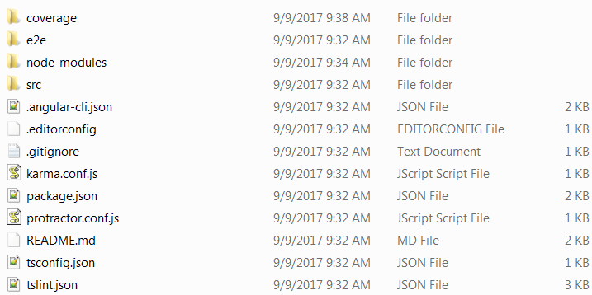
Angular 2 – app structure
Notes:
APP Folder structure:-
e2e/
Inside e2e/ live the end-to-end tests. They shouldn't be inside src/ because e2e tests are really a separate app that just so happens to test your main app. That's also why they have their own tsconfig.e2e.json.
node_modules/
Node.js creates this folder and puts all third party modules listed in package.json inside of it.
.angular-cli.json
Configuration for Angular CLI. In this file you can set several defaults and also configure what files are included when your project is built. Check out the official documentation if you want to know more.
.editorconfig
Simple configuration for your editor to make sure everyone that uses your project has the same basic configuration. Most editors support an .editorconfig file. See http://editorconfig.org for more information.
.gitignore
Git configuration to make sure autogenerated files are not commited to source control.
karma.conf.js
Unit test configuration for the Karma test runner, used when running ng test.
package.json
npm configuration listing the third party packages your project uses. You can also add your own custom scripts here.
protractor.conf.js
End-to-end test configuration for Protractor, used when running ng e2e.
README.md
Basic documentation for your project, pre-filled with CLI command information. Make sure to enhance it with project documentation so that anyone checking out the repo can build your app!
tsconfig.json
TypeScript compiler configuration for your IDE to pick up and give you helpful tooling.
tslint.json
Linting configuration for TSLint together with Codelyzer, used when running ng lint. Linting helps keep your code style consistent.

Slide 17
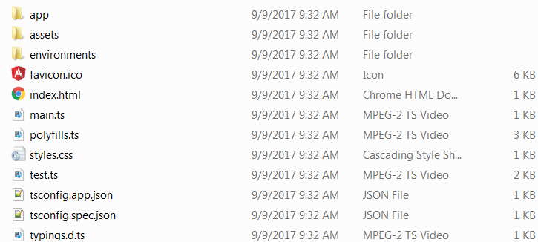
Angular 2 – app structure (cont.)
Notes:
SRC Folder structure:-
app/app.component.{ts,html,css,spec.ts}
Defines the AppComponent along with an HTML template, CSS stylesheet, and a unit test. It is the rootcomponent of what will become a tree of nested components as the application evolves.
app/app.module.ts
Defines AppModule, the root module that tells Angular how to assemble the application. Right now it declares only the AppComponent. Soon there will be more components to declare.
assets/*
A folder where you can put images and anything else to be copied wholesale when you build your application.
environments/*
This folder contains one file for each of your destination environments, each exporting simple configuration variables to use in your application. The files are replaced on-the-fly when you build your app. You might use a different API endpoint for development than you do for production or maybe different analytics tokens. You might even use some mock services. Either way, the CLI has you covered.
favicon.ico
Every site wants to look good on the bookmark bar. Get started with your very own Angular icon.
index.html
The main HTML page that is served when someone visits your site. Most of the time you'll never need to edit it. The CLI automatically adds all js and css files when building your app so you never need to add any <script> or <link> tags here manually.
main.ts
The main entry point for your app. Compiles the application with the JIT compiler and bootstraps the application's root module (AppModule) to run in the browser. You can also use the AOT compiler without changing any code by passing in --aot to ng build or ng serve.
polyfills.ts
Different browsers have different levels of support of the web standards. Polyfills help normalize those differences. You should be pretty safe with core-js and zone.js, but be sure to check out the Browser Support guide for more information.
styles.css
Your global styles go here. Most of the time you'll want to have local styles in your components for easier maintenance, but styles that affect all of your app need to be in a central place.
test.ts
This is the main entry point for your unit tests. It has some custom configuration that might be unfamiliar, but it's not something you'll need to edit.
tsconfig.{app|spec}.json
TypeScript compiler configuration for the Angular app (tsconfig.app.json) and for the unit tests (tsconfig.spec.json).

Slide 18
references
HTML- https://www.w3schools.com/html/
CSS- https://www.w3schools.com/css/default.asp
JAVASCRIPT- https://www.w3schools.com/js/default.asp
ANGULAR 2- https://angular.io/guide/quickstart
ANGULAR CLI- https://github.com/angular/angular-cli/wiki
VISUAL STUDIO CODE(EDITOR) - https://code.visualstudio.com/
NODE JS - https://nodejs.org/en/

Slide 19
Let’s get cracking..!!!

